Slide 1
Module 2: Quantitative Reasoning
Week 4

Slide 2
Overview
What is QR?
Why it is important?
Steps it involves?
Concepts of all the methods used in QR
Applications?

Slide 3
Quantitative Reasoning (QR)
QR is the application of mathematical concepts and skills to solve real-world problems – reading and using data, understanding evidence and applying basic quantitative skills /logical reasoning to obtain solution.
QR is the process of interpreting and making logical decision from the available information/data.

Slide 4
What is the importance of QR?
Managers, healthcare professionals, business executives, architects, engineers, real estate agents, and scientists need quantitative reasoning measure. The professionals mentioned above need to apply quantitative skills to make logical decision in their day-to-day life.
Diagrams, charts/plots, and graphs are beneficial when figuring out how to solve a problem based on analysing the information given using either math skills or the ability to think quantitatively.

Slide 5
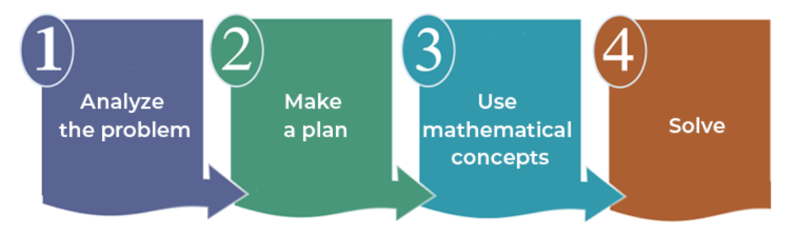
What are the four steps of the QR process?
Framing concrete numerical questions
Identifying tools and data for analysis
Building models to analyse the data
Analysing the results, you obtained

Slide 6
Example: Finding Efficacy of a Drug
Framing concrete numerical questions
Is experimental Drug better or efficient in treating a headache?
2. Identifying tools and data for analysis
Data required: demographic details of patients, type
of treatment (drug/placebo), outcome details (time taken
by the drug to show effect) - any other?
Basic Tool: to analyse the data – Excel, programming, or any
other statistical/data analysis tools.
3. Building models to analyse the data
Basic descriptive approach or higher-level models
4. Analysing the results, you obtained
Interpret the results obtained

Slide 7
Data
Trial | Drug | Placebo
1 | 23 | 17
2 | 24 | 24
3 | 19 | 28
4 | 27 | 18
5 | 18 | 27
6 | 16 | 28
7 | 19 | 24
8 | 12 | 14
9 | 18 | 18
10 | 23 | 24
11 | 15 | 16
12 | 25 | 18
13 | 12 | 19
14 | 35 | 24
15 | 18 | 19
16 | 21 | 22
17 | 31 | 26
18 | 14 | 17
19 | 26 | 17
20 | 20 | 23
21 | 25 | 22
22 | 14 | 23
23 | 12 | 14
24 | 19 | 28
25 | 25 | 20
26 | 25 | 13
27 | 16 | 32
28 | 12 | 18
29 | 26 | 28
30 | 15 | 24
Analysing the distribution of your data is important – it can have a significant impact on the results of your analysis.
Understanding the distribution of your data can help you choose the right statistical test, identify outliers, and visualize the data.
By understanding the distribution of your data, you can ensure that your results are accurate, reliable and valid.

Slide 8
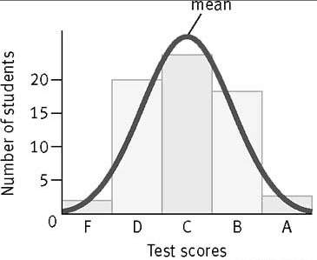
Methods: Mean (Average) and Normal Distribution
Mean – summarizes an entire dataset with a single number representing the data’s center point or measure of central tendency.
Normal Distribution – distribution that is symmetric about the mean, showing that data near the mean are more frequent in occurrence than data far from the mean.
Example: distribution of test grades. Most students will score around the average or mean, with a few high scores and a few low scores. This means that most students get C’s, while only a few get A’s and F’s.

Slide 9
Tool: Excel
Excel is a spreadsheet program that allows one to enter numerical values or data into the rows or columns of a spreadsheet and to use these numerical entries for calculations, graphs, and statistical analyses
Spreadsheet – is the computer equivalent of a paper ledger sheet. It consists of a grid made from columns and rows.
The spreadsheet environment can make number manipulation easy and somewhat painless.

Slide 10
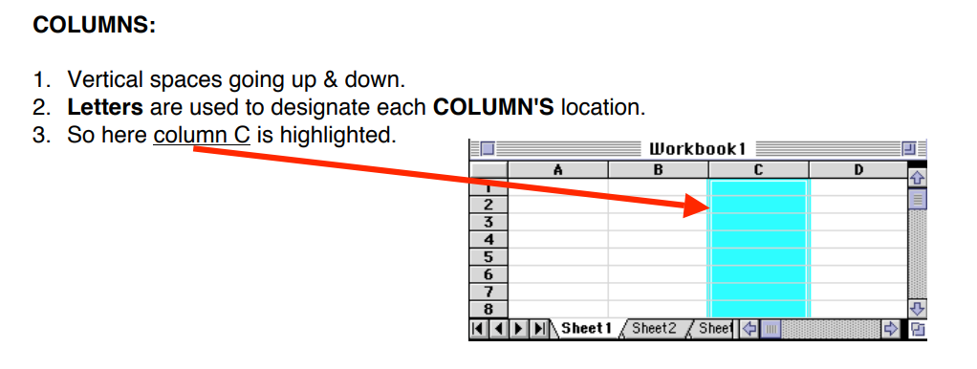
Spreadsheet Basics
Spreadsheets are made up of…
Columns
Rows
Cells

Slide 11
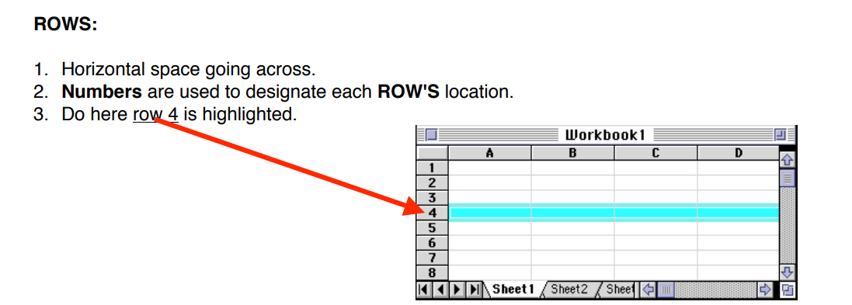
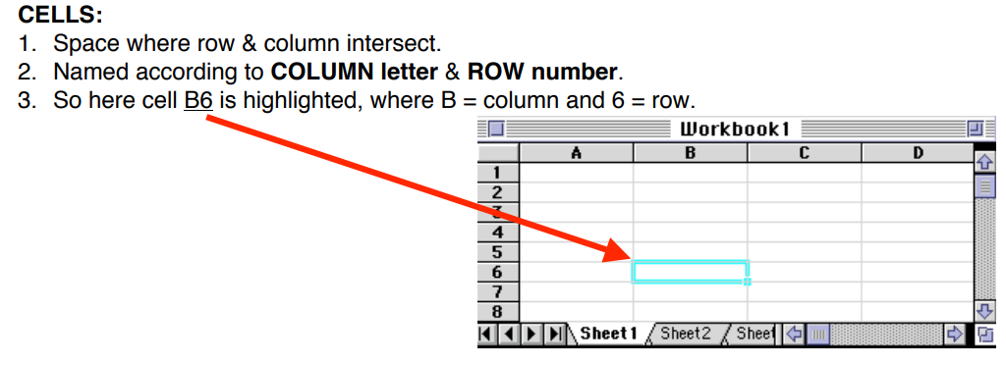

Slide 12
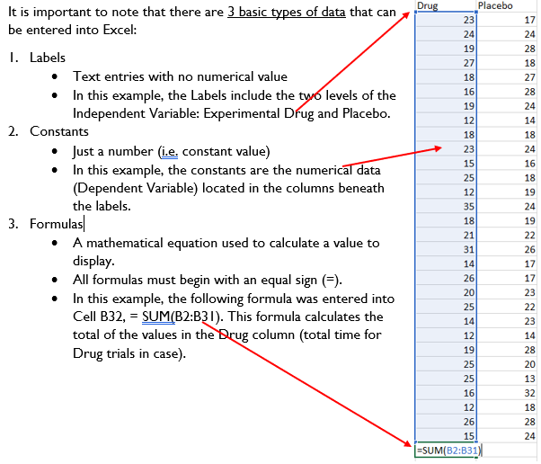
Types of Data

Slide 13
Using Excel to calculate Descriptive Statistics
Formulas or Functions
Remember that when creating formulas or functions, it is important that you BEGIN it with an equal sign (=).
Common functions that you will use,
The Sum function
The Average function
The Standard Deviation function
A list of formulas or functions is available within Excel under the menu Formula, down to Insert Function
You can also manually insert formulas by typing them directly into the cell where you want the result of the formula to appear.

Slide 14
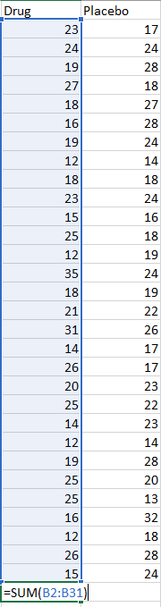
The SUM Function (SUM)
The SUM Function takes all of the values in each of the specified cells and totals their values.
For example: to get the sum of all the experimental drug group

Slide 15
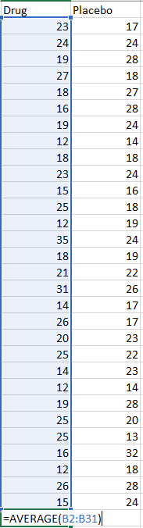
The AVERAGE function (AVERAGE)
Drug | Placebo
20.17 | 21.5
The AVERAGE is a measure of central tendency and gives you an idea of the typical score.
For example: to get the average of the Drug Group
Interpretation: Based on the mean values, can we say:
the drug is better in treating the headache on an average.
Or drug is faster in treating the headache on average compared to the placebo.

Slide 16
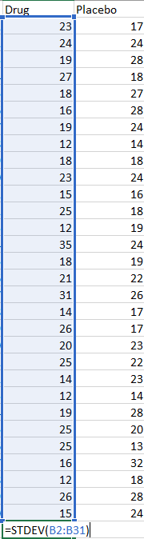
Standard Deviation Function (STDEV)
This function finds the standard deviation of the specified data. The standard deviation is a measure of the spread of variance of the data and gives you an idea of how different each score is from the average.
For example – to get the standard deviation of experimental drug group

Slide 17
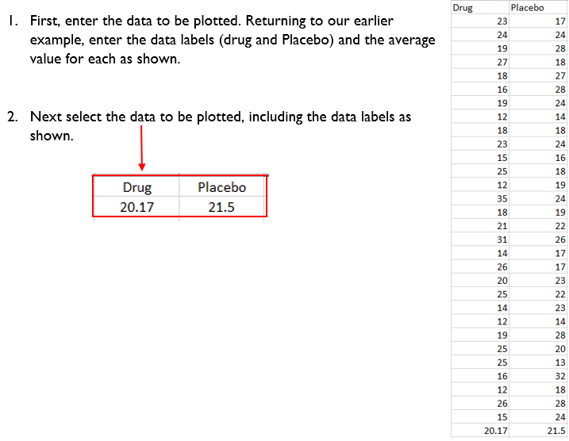
Making a Chart using Excel 2007 or Newer version
Another important feature of Excel is the Chart – also called a graph.

Slide 18
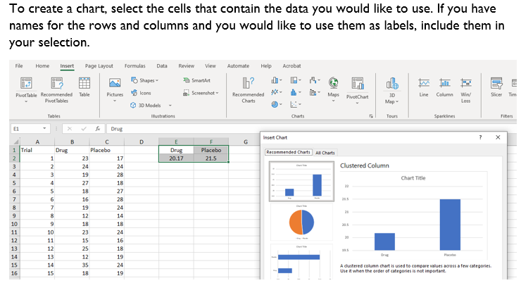

Slide 19
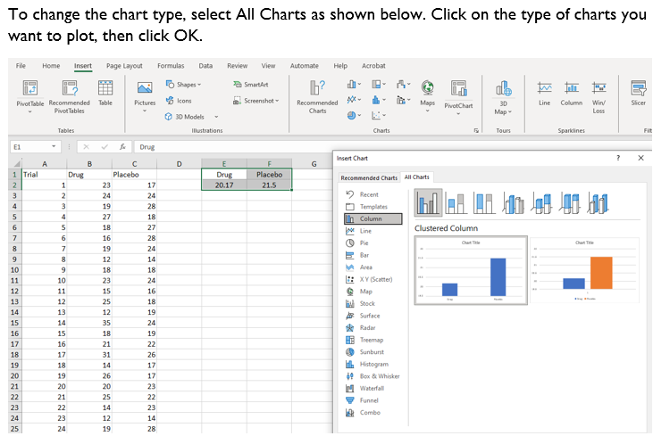

Slide 20
Other Example: House Price Estimation
Framing concrete numerical questions
Estimating or predicting the house price (decide on the time horizon)
2. Identifying tools and data for analysis
Data required: age, area, quality, - any other?
Basic Tool: to analyse the data – Excel
3. Building models to analyse the data
Basic descriptive approach or higher-level models - Estimation or predictive model
4. Analysing the results, you obtained
Interpret the results obtained

Slide 21
Any other examples?
Finance/Business
Medicine/healthcare
Engineering
Environmental
Social science

Slide 22
Tutorial: Understanding the basics of quantitative reasoning
In the two week’s activities, the students will learn the step-by-step methods involved in performing data analysis.
In the two weeks of module 2 tutorial activities, you will learn the step-by-step Quantitative Reasoning methods involved in performing data analysis. Upon completion of the lesson, students will be able to apply quantitative reasoning techniques to analyse data to support decision-making.
Today:
Each group will perform the data collection
Each group to understand one digital tool (Microsoft Excel) and its basic techniques to use them on collected data for analysis and decision making.
Follow the instructions given to you in tutorial to complete these activities.
Approach your tutor, if you have any difficulties.

